Slide 1
What are opportunity classes and selective high schools?
Who benefits?

Slide 2
AIMs
Selective high schools cater for academically gifted and high potential students by providing intellectual stimulation through an educationally enriched environment.
Notes:
Opportunity classes/selective high schools cater for gifted and high potential students. These are students who are intellectually superior and who perform to a very high standard in class.
Many people think that bright students will rise to the top wherever they are placed. There is evidence that where the social and academic needs of bright, highly achieving students are not met, the students can become depressed, they can underachieve and they can even drop out of schooling as soon as they are able.
These opportunity classes are intended to bring together students who could otherwise be socially and academically isolated from other students who have similar abilities and work to the same standards.

Slide 3
purpose
Highly gifted and high potential students can become disengaged and underachieve if their educational needs are not met.
These students need a larger peer group to challenge and support them.
They also need specialist teaching techniques and dedicated resources.

Slide 4
What is different?
Students do not have to wait for slower learners
Teachers can use specialised resources and techniques
Students form social and academic networks
Very bright students don’t feel isolated
Notes:
Teachers can work with students at the speed and intensity they need. Students who understand the material already do not have to sit idly by while it is repeated for the benefit of those students who have difficulty with it. (Less repetition)
Teachers can use texts, and other resources which are most suitable to students at this level without worrying that they will not reach the rest of the class. They can also use teaching techniques which are known to bring the best out of high potential and gifted students, such as open-ended tasks which allow them to reach beyond what is expected of them.
Most of all, bright, highly-achieving students are co-operative learners and form social and academic networks to help and challenge each other. These classes make these networks easier to set up.

Slide 5
Characteristics of gifted and HIGH POTENTIAL STUDENTS
learns rapidly
excellent memory
creative or imaginative
independent
sense of humour
highly motivated
critical thinker
superior leader
questions
socially and morally responsible
advanced vocabulary
draws inferences
advanced reader
advanced interests
Notes:
This is a ‘limited’ list of some of the characteristics. If your child displays some of these qualities then you may consider applying for SHS/OC placement.

Slide 6
Number of opportunity classes
There are 76 schools with opportunity classes
45 in metropolitan Sydney
31 in rural or regional centres
There are 1740 Year 5 places across NSW.

Slide 7
Why read the application information?
When is the test?
Where & when to apply?
What if the student is sick?
Which schools to choose?
You know what to expect from the process.

Slide 8
How will I know when to apply?
The school will send you a letter with a tear-off section to return to the school to say you will be applying.
This tear-off section is not the application.
You will be directed to the website where you can apply online.

Slide 9
Application dates
For Year 5 opportunity class placement in 2021
Online applications:
open on Tuesday 9 June 2020
and close on Friday 26 June 2020.

Slide 10
Completing an online application
Go to the application link on the website and register, using your own email address.
You will receive an email with a password and a link to the application.
You will login to the application using the password you were given. (copy and paste)
What will you be asked?
Notes:
Your school will probably ask you to complete an Intention to apply form. You should be aware that this is not an application and its purpose is to allow schools to know which students will require SAS.

Slide 11
Completing an online application
You will be able to save your application and return to it if you cannot complete it at one sitting.
The application is not complete until you ‘Submit’.
Once you submit your application you will receive an email acknowledgement with:
a header sheet for any attachments
a summary of all the information you submitted
application number
All changes must be requested in writing.
Apply once only. Closing dates are strictly applied.
Notes:
If you make an error in completing your application you should write to the Unit quoting your child’s full name and application number and the change. Do not submit another application.

Slide 12
Choices
You can choose up to three choices for SHS and up to two choices for OC.
Place all choices in priority order.
Do your research!
view school websites
consider transport
consider friendship groupings
Don’t choose a school you don’t really want.
Notes:
Please note that as part of the SHS review that:
Family Placement Claim will no longer be a part of the selection committee deliberations
twins will no longer be given consideration
Parents will only get three choices instead of four.

Slide 13
Order of choices
Put the choices in the order you really want.
The order in which you list those choices matters if the child qualifies for more than one choice.
If your child qualifies for more than one choice, you will be offered only the highest choice for which the child qualifies.

Slide 14
Example of an oc placement outcome information
If your child qualifies for both choices:
Greenacre Public School – Offer
Picnic Point Public School – Not applicable

Slide 15
Change of choice
Before Friday 25 September 2020 for OC entry in 2021
All requests for a change of choice must be made in writing.
Requests made after this date:
require details and evidence of the extenuating circumstances
require approval
may be considered as an appeal.
Changes cannot normally be made after placement outcomes are released.
Choices cannot be added or changed on the grounds that the students did not qualify for their original choices.
Notes:
All such late requests will require documentary evidence to support the claim. This might include a contract of sale or lease on a new residence and utilities bills such as phone or electricity account clearly showing the new address.

Slide 16
Criteria for entry
In 2020, to ensure the fair and consistent assessment of students across all schools and regions of NSW, students will be placed on test results only.

Slide 17
Opportunity class placement
Tests:
Written by ACER
Two x 30 mins tests
35 questions in each test with mixed English, mathematics and general ability (multiple-choice questions)
Students sit the test. This includes:
Reading
Mathematics
General Ability
Notes:
There are two parts to the test – Parts 1 and 2.
Each Part takes 30 minutes and consists of a mix of 35 multiple choice questions in English, mathematics and general ability.
There are 20 questions for English and mathematics and 30 general ability questions.
For each test component, the test score is scaled to a mean of 60 and a standard deviation of 12. The process does not convert the test score to a percentage score.

Slide 18
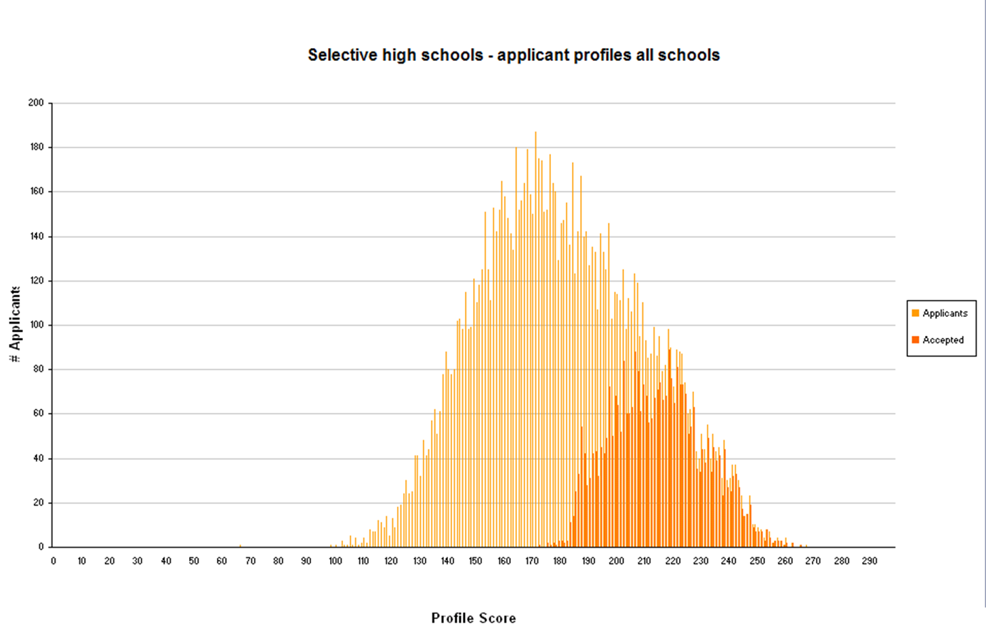
Notes:
What level of academic merit is required for selective high school entry?
This chart shows the end of the academic spectrum from which we are drawing our applicants and our successful enrolments in the selective high school placement program state-wide. The Opportunity class placement program charts would look fairly similar.
The light orange shading in this chart represents the scores of all the applicants for selective high school entry in 2009 while the dark orange shading shows the profile scores of students accepted for placement in selective high schools. This chart does not include the residential agricultural students who are considered on isolation criteria as well as academic merit.
Unsuccessful applicants range from roughly 100 to 173 out of 300 in profile score and fit into the average to bright normal IQ categories.
Students accepted for selective high school entry range in profile score from around 175 to 270 and fit into the superior to very superior IQ categories.
If we compare the profile scores on which students are considered for opportunity class entry with IQ ranges, in general the academic merit of students who apply for opportunity class entry ranges from the average to the very superior as you can see from the lightly shaded section of this chart.
However the students who are successful for opportunity class school entry are usually in the superior to very superior range of academic merit.

Slide 19
Test items
What types of items are in the Selective High School Placement Test?

Slide 20
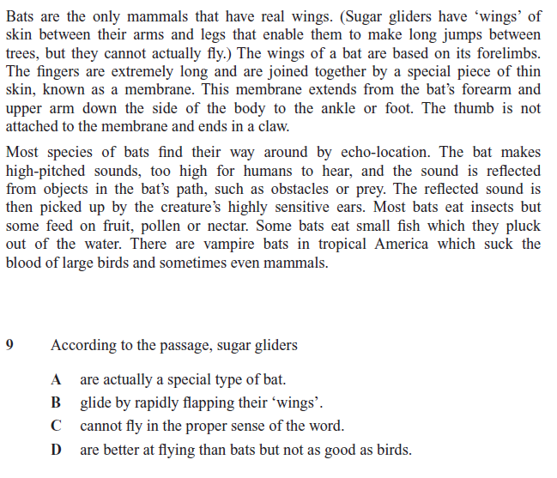
Sample oc english test item
Notes:
The English items all consist of passages of varying text types including poetry, fiction or non-fiction prose with a number of inferential comprehension questions.
This example is one of the practice items and is therefore quite easy. In the real test the passages and their questions are very challenging. Students have slightly less than a minute to read and answer each question.
Answer is C

Slide 21
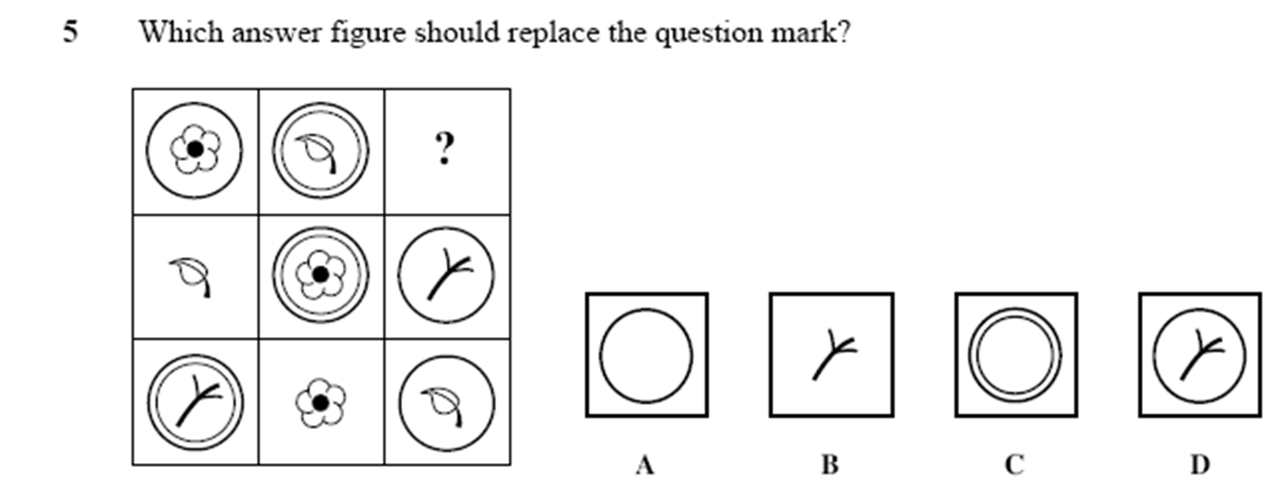
Sample oc general ability test item
Notes:
This is an example of a general ability question.
Answer is B

Slide 22
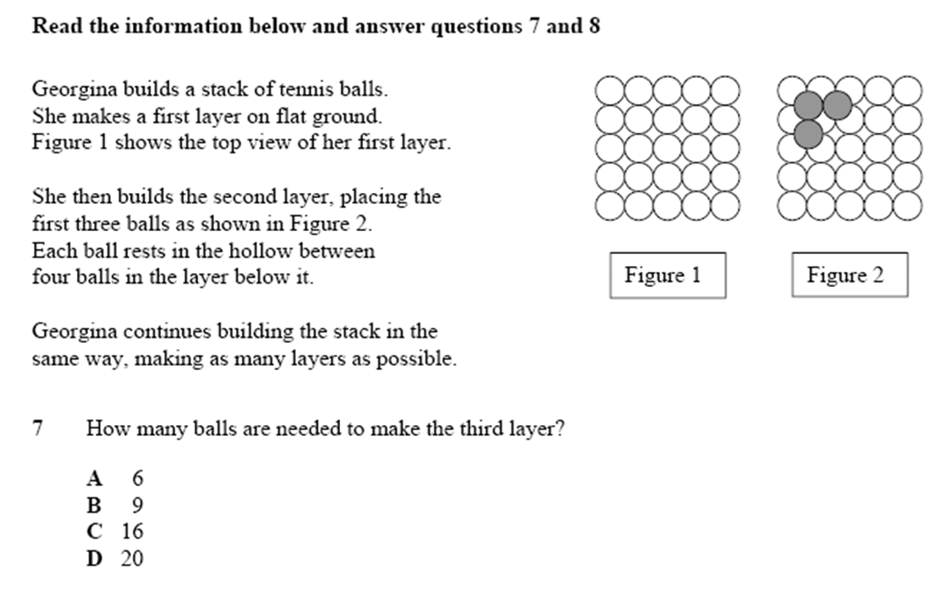
Sample oc mathematics test item
Notes:
And this is an example of a mathematics question.
Answer is B

Slide 23
Preparation
Test technique - speed and type of questions, no marks deducted if wrong
Sample papers - on the Unit’s website, not a prediction of success
Answer sheets - use pen supplied to shade squares, correct by crossing out
Sleep - lifts performance
Reduce pressure – endless coaching and being told how important this test is does more to scare students than motivate them
OC: https://education.nsw.gov.au/public-schools/selective-high-schools-and-opportunity-classes/year-5/the-test
SHS: https://education.nsw.gov.au/public-schools/selective-high-schools-and-opportunity-classes/year-7/the-test
Notes:
Practice with multiple-choice questions of any sort may help students become familiar with test technique. There will be a practice session before the test begins to ensure that students are fully prepared.
Past test papers are available on the website to assist students. Items that assess English may be available after copyright permission to publish them is obtained.

Slide 24
Test dates
Opportunity Class Placement Test for Year 5 entry in 2020
Wednesday 16 September 2020
Key dates: https://education.nsw.gov.au/public-schools/selective-high-schools-and-opportunity-classes/general-information

Slide 25
Special considerations
Special test provisions
Illness/Misadventure claims
Appeals

Slide 26
Special test provisions
In general the kinds of requests that can be granted include:
permission to eat, take medicine or use a puffer during the test
that seating be arranged near the front to cater for a student’s partial hearing impairment
provision of large-print papers and double desks to accommodate them
Transcription of the answers of physically impaired students from question booklets to answer sheets.
Notes:
Special Test Provisions
Some applicants request special test provisions for their children because of a disability eg. Students with ADHD, Aspergers Syndrome can be seated at the front of the test centre; large print papers van be arranged for students with visual impairments; FM web transmitter can be arranged for students with hearing impairments.
Parents and/or Principals can make this request on the application form. The Unit will evaluate the feasibility of the request and writes to both the applicant and the principal explaining whether the request can be granted.
Generally the types of STP requests that are not approved are permission to use a computer, extra time and requests for scribes.

Slide 27
After the test
How are placement decisions made?

Slide 28
Illness/Misadventure
All claims relating to illness must be accompanied by a medical certificate and ‘independent evidence of illness’.
Usually targets the test but can apply to school assessments:
either the student has missed the test
or something has prevented the student from doing his or her best in the test or at school in the last year.
Claims must be in within 14 days from the date of the test.
Notes:
Illness/misadventure
If a problem such as sickness or an accident stops your child from doing his or her best, parents can download an illness/misadventure form from the Department’s website. A medical certificate is required to cover the test date if your child was sick.
Generally it is better to take the test where possible and make an illness/misadventure claim than to miss the test. Must be submitted within 14 days of the test.

Slide 29
Selection committees
Principal of the SHS or the OC
Other staff members, as required
Parent representative (SHS only)
School Counsellor or DGO (OC only)
Committees decide on:
special considerations
first round offers and initial reserve lists
unsuccessful candidates.
Notes:
Selection committees make all placement decisions for SHS entry.
They determine:
First round offers
Reserve list
Unsuccessful list.

Slide 30
Considerations
Aboriginality
EALD – doing most school work in the English language for less than 4 years
Disabilities
Age
Year
Repeating students
Selection committee attention
Illness/Misadventure claims
Notes:
Family placement claims and siblings (most often twins or triplets) are no longer given consideration.

Slide 31
Placement outcome information
From 1 December 2020
By mail or email (please keep details up to date with Unit, ensure email accepts attachments)
Calculated placement score will be listed on outcome letter
You are sent more detailed raw scores as well

Slide 32
Appeals
Panels consider appeals based on factors affecting either school performance or test performance that may not have been known at the time of the test or presented to the selection committees.
Supporting evidence must be provided.
The panel is made up of the Director, Business Systems or nominee, a school counsellor, a primary OC principal, a secondary SHS principal and a parent representative.
Grounds for appeals have been clarified. Invalid grounds are listed on the website
An appeal is not a substitute for a late Illness/Misadventure claim.
Notes:
Appeals will only be submitted to an appeals panel if they are based on valid grounds.
Appeals will generally not be considered valid on the following grounds:
· the same grounds as those submitted on an illness/misadventure claim
· illness, anxiety or stress at the time of the test. These are medical matters which should have been treated at the illness/misadventure stage
· test centre problems such as disruptions during the test or suspected shorter time given for the test as these are matters which should have been treated at the illness/misadventure stage
· suspected misalignments. These should have been considered after the test during the illness/misadventure stage
· suspected problems with the teacher; for example extended teacher absences or changes of teacher
· the process used to determine academic merit - e.g. lack of school scores which can be moderated or consideration of IQ results in the interstate/overseas application process
· lack of familiarity with the process, language, culture and education system
· the student's academic performance on other measurements or reports e.g. IQ score, NAPLAN results, ICAS testing, school reports or certificates and scholarship testing
· academic performance before Year 3 or after June – and for selective high schools, before Year 5 or after December in the Year 5 year.
· anything voluntary that stopped the child from sitting the test or from doing his or her best in the test, such as participation in entertainment, sporting events, attendance at excursions or camps, or a holiday trip.

Slide 33
Contact details
High Performing Students Unit
Telephone: 1300 880 367
Email: ssu@det.nsw.edu.au
Website: https://education.nsw.gov. au/public-schools/selective-high-schools-and-opportunity-classes/updatesOpportunity

Slide 34
facebook
facebook.com.au/Opportunityclassplacement

