Slide 1


NAPLAN Online 2019
Parent information

Slide 2
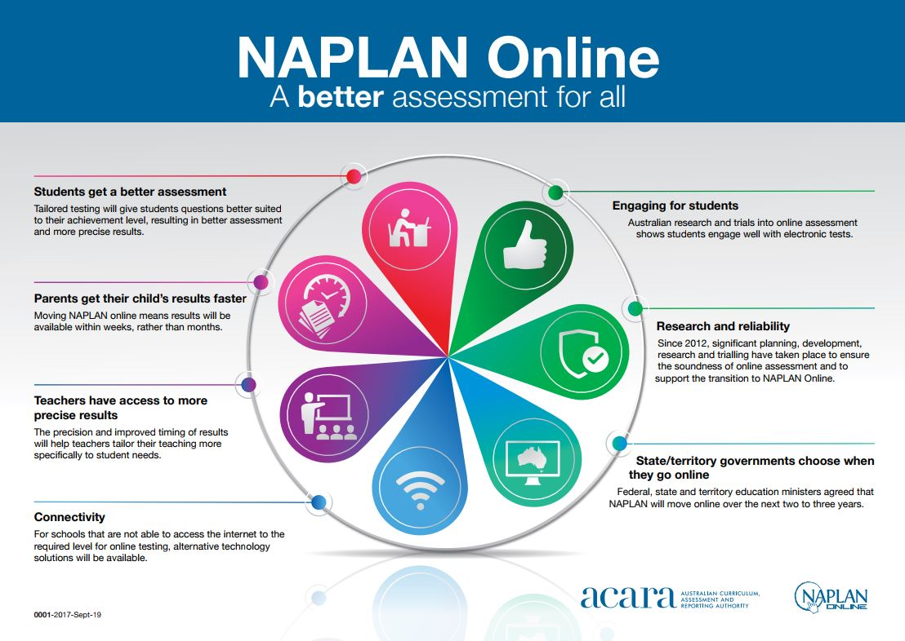
Notes:
Schools are preparing students for the world that is here and the world that is coming: a future with ICT at its core. The move to online assessment is a natural progression of the increasing use of ICT to enhance student learning in classrooms across Australia. NAPLAN Online is a new era for NAPLAN.
Why move to NAPLAN Online?
Better Assessment – diversity in assessment tasks, & assessing broader range of skills and content.
More precise results - Tests are tailored to student ability, which will provide more precise results & keeps students engaged.
Faster turnaround of information - results available more rapidly; enabling teachers to identify learning priorities early and tailor teaching to address student needs.

Slide 3

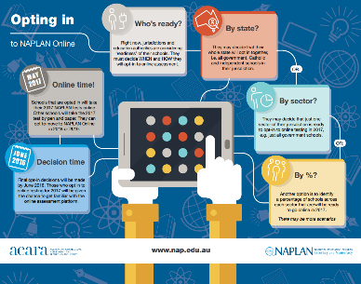
Different opt in strategies
All schools will transition from 2018 on an opt-in basis.
School, teacher and student readiness
Indicative year of first online assessment
School Readiness – technical capacity for students to undertake assessment in testing window (9 days over 2 wks)
Teacher Readiness –test administration within defined test session (i.e. class logistics and minor device management)
Student Readiness- ensuring students have sufficient ICT skills and are familiar with devices and peripherals to undertake the assessment
2019
2018
Schools: 83
Students: 15 885
2018
Schools: 274
Students: 43 326
2018
Schools: 141
Students: 19 045
2018
Schools: 555
Students:67 104
2018
Schools: 124
Students: 25 289
2018
Schools: 108
Students: 20 777
2019
3

Slide 4
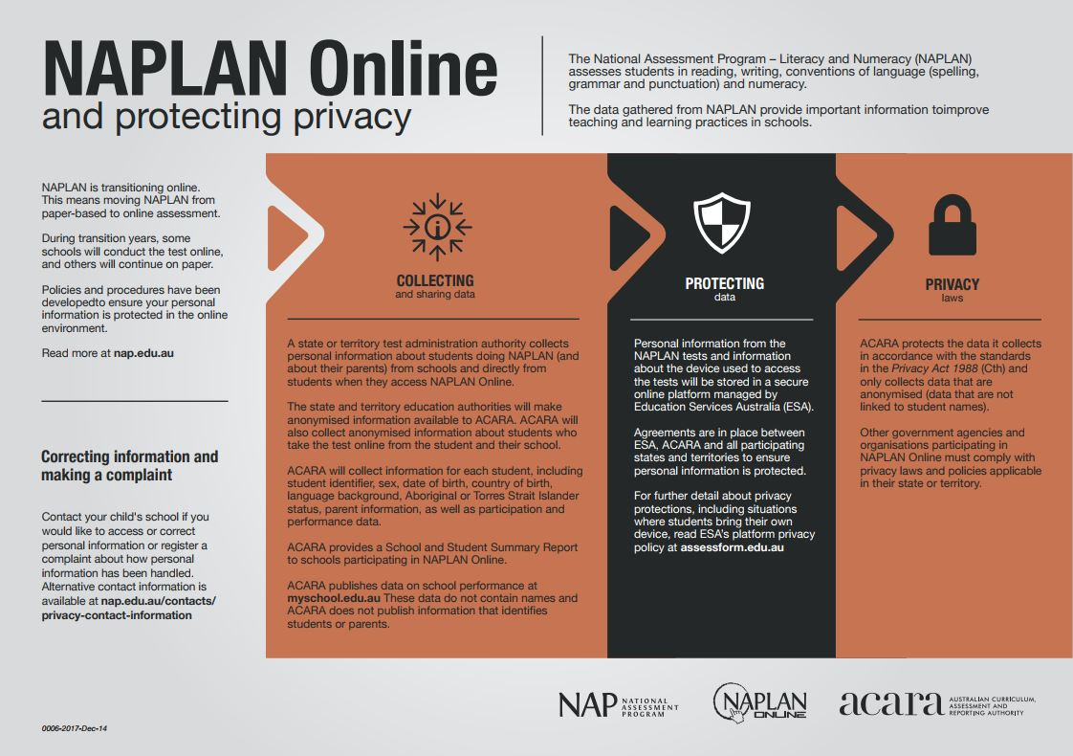

Slide 5
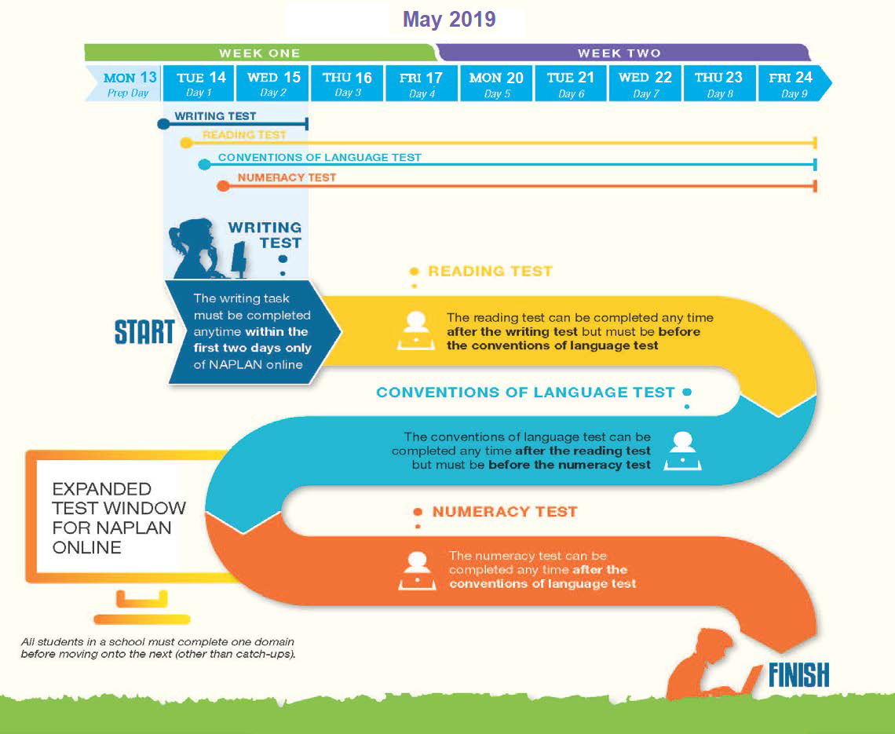
NAPLAN Online Testing Schedule
2 day testing window for Writing Test for ALL class groups.
Reading test completed prior to performing the Conventions of Language test.
Reading test result will differentiate the Conventions of Language test.
Followed by any catch-up tests required.
SEQUENCE IS IMPORTANT
Notes:
The testing schedule follows the order of :
Writing
Reading
Language Conventions and then finishes with ;
Numeracy.
The Writing test has a 2 day window to be completed by all schools. This 2 day window exists to ensure the security of the writing prompt. The Year 3 students will continue to perform writing in booklets and not online. Writing Year 3 tests must be completed on the morning of the 1ST Tuesday and must be sent back on 1st Friday.
Years 5, 7 and 9 students will perform their writing test online.
Minimum 20 minute break between tests is protocol.
All classes in all year levels must complete a test domain before moving to another test domain.
Once the student completes the reading test, the branching and differentiation for individual testing levels will begin.
School community must be aware of the schools scheduling prior to testing beginning.

Slide 6
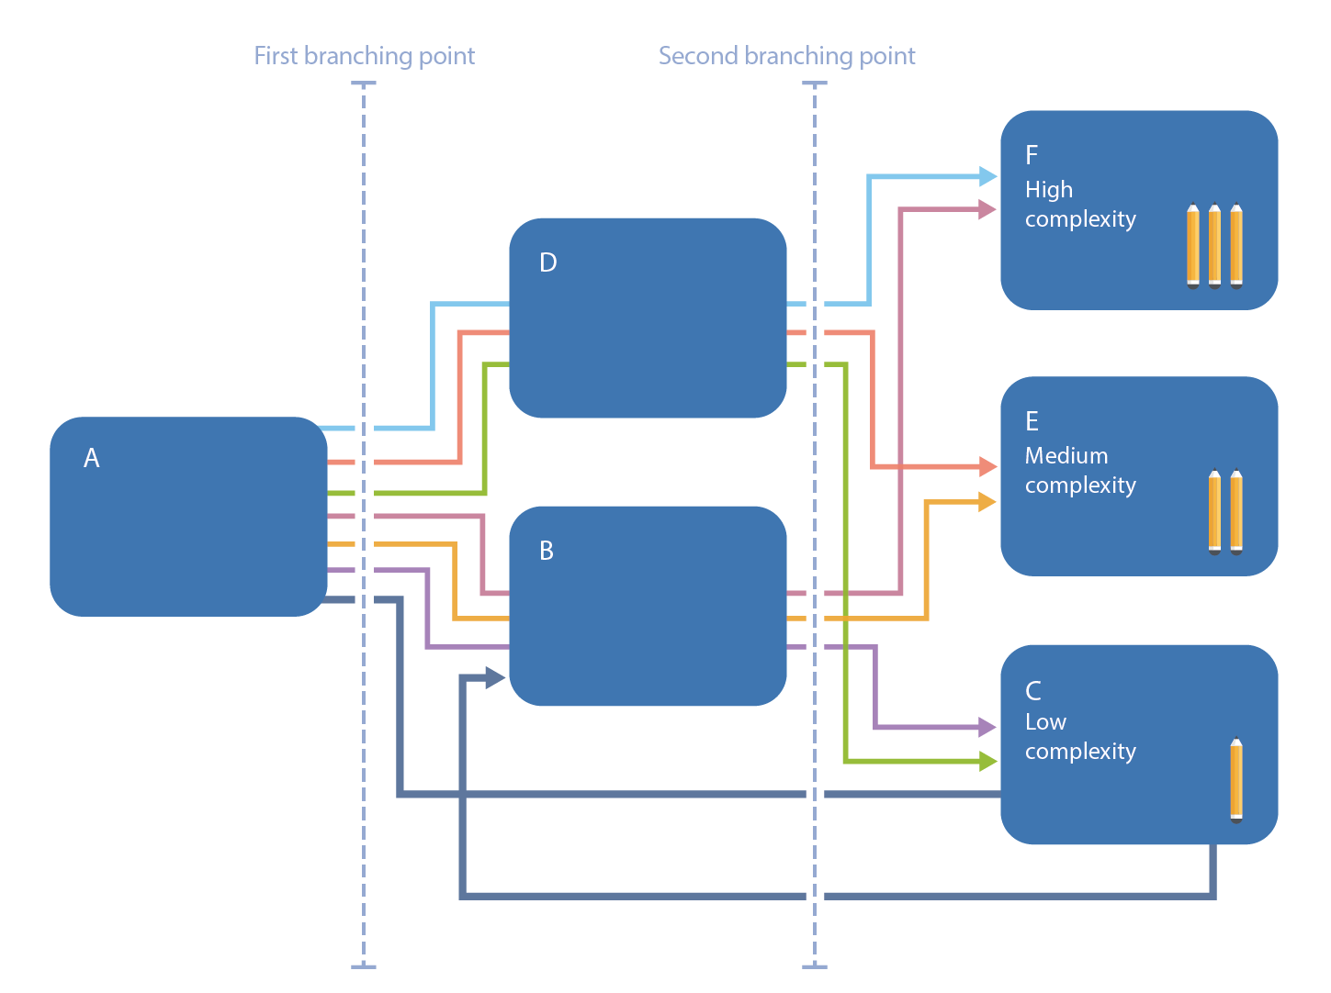
How will tailored testing work for NAPLAN Online?
Automatically adapts to a student's performance
Asks sets of questions that match the student achievement level
http://nap.edu.au/online-assessment/research-and-development/tailored-tests
Notes:
TAILORED TESTING Check The proposed tailored test design consists of three stages and has two branching points.
All students at each year level start with the same set of questions (testlet A). The computer system scores the student's answers automatically and the student then progresses to a second testlet. The second testlet may be easier (B) or more difficult (D) than question A, depending on the student's achievement. At the end of the second testlet, the student is directed to a third testlet, again depending on achievement. The final testlets are of varying difficulty: hard (F), medium (E), easy (C).
In practical terms, the tailored test design can help students who might be struggling with items in testlet A to engage with the rest of the test. This test pathway takes students who correctly answer few, if any, items in testlet A directly to testlet C. This provides these students with an early opportunity to respond to the easiest testlet and thus re-engage with the test. Once these students respond to testlet C, they are routed to testlet B so that they get an opportunity to demonstrate the extent of their knowledge.
Key benefits of tailored testing:
encourages participation in the test and is more engaging for students •
matches student achievement levels, without increasing test length •
measures student achievement more precisely (especially for higher performing and struggling students) to inform teaching and learning.
Trials of the tailored test design suggest that students are more engaged with tests that adapt to their achievement. Students who struggle early in the test are given questions that are more suited to their performance, so that students are less likely to become discouraged as they progress through the tests. High-achieving students are given questions that they find more challenging
If students get different questions, how can results be comparable? Every student is tested on the same curriculum content and knowledge for their year level, regardless of the questions they are asked. Questions will continue to be placed on the NAPLAN scale, ensuring results are comparable for all students.

Slide 7





Notes:
A carefully planned transition approach supports each school with moving online when it best suits their students, staff and school community.
Schools that support contemporary practices and whole-school approaches in the effective use of ICT are well positioned to make the transition.
What does School Readiness look like?
It involves all 3 areas of :
Educator readiness, student readiness and technical readiness. (All linked and all reliant on each other)

Slide 8

  Dashboard training– understanding of capacity/issues
  Bandwidth capacity and management support through training and Connect communities.
Whole-school approaches to the effective use of ICT – timetabling, updates, wireless configuration
Gateway Check including:
Scheduling and room setup
Bandwidth
Device and peripherals
Assessment of school ICT growth plans and budgets
Locked Down Browser (LDB) is installed on each device and required to access NAPLAN Online testing. Creates a secure test environment for students to conduct NAPLAN online.
Standard Operating Environment upgrades , training and support through SOE Fundamentals.
Assessing the student device requirements to ensure they are met:
Headphones
Keyboard
Network
Security
Notes:
Technical Readiness of the school is about :
Engaging community and assess technical needs
School leaders have worked with their staff to develop a whole-school transition approaches to NAPLAN Online. These include:
whole-school approaches to the effective use of ICT
community engagement resources
school technical readiness checks, including:
Assessment of school ICT growth plans and budgets
Schools complete a technical readiness checklist that identifies current devices, spaces and network capabilities.
Identify early issues and any additional resources and support that may be required.
Use of the Capacity Calculator to further support technical readiness assessment. https://capacitycalculator.det.wa.edu.au/
Schools plan and map out their ICT commitments in line with the usual school planning for curriculum resourcing. ICT infrastructure for NAPLAN Online should be a natural flow on from what is used to deliver the curriculum at your school.

Slide 9

A whole-school approach to assessment provides a balanced assessment approach using paper and digital modes, across curriculum areas and year levels. If an assessment is digital, the supporting lessons, units and teaching practices should align and support digital practice.
Support staff in their NAPLAN Online roles.
The Department, provides
School Readiness training
and support through workshops,
technical support, training
in managing schools technical infrastructure, as well as
videos and guides.
Foster digital pedagogies and online assessment.
School Readiness Connect communities established to house latest NAPLAN Online updates and support resources for schools.
ICT capability is a general capability in the Western Australian Curriculum. Schools can foster and support contemporary teaching and learning practices.
Proficiency with ICT
aligned with
AITSL
teacher standards.
Notes:
Teachers who are planning, teaching and assessing using the Western Australian Curriculum are already embedding the ICT skills students will use in online assessment. Capitalise on these opportunities to further develop relevant ICT skills without having to plan any additional learning programs or practice. Educators in Australia must also ensure they have proficient ICT skills to comply with AITSL teacher standards, this ensures our teachers are able to support to use contemporary practices that assist students to have positive experiences with online assessment.

Slide 10
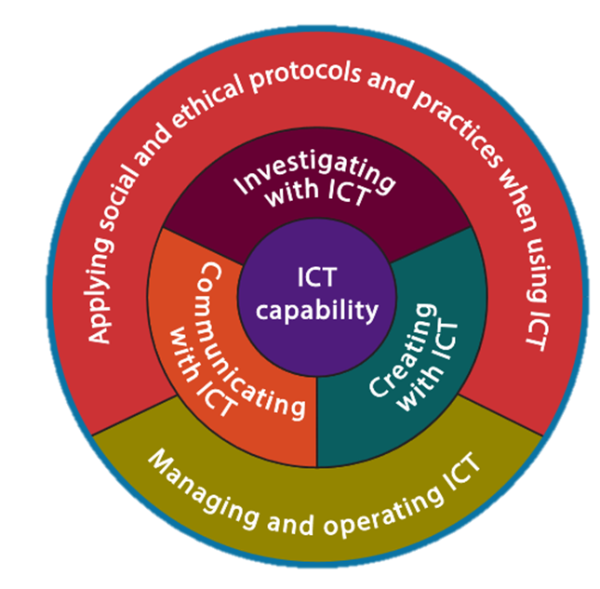
ICT skills
  General Capabilities and Technologies Curriculum are separate distinct entities
  Technologies Curriculum has two strands Design and Digital
  Both share Create Solutions skill set
  Integration is crucial to success

Slide 11

Students read, plan and compose digital texts.
Students use headsets, manipulate objects, and navigate on screen.
Support students to become familiar with the NAPLAN Online assessment platform and confident with technology-enhanced questions.
Students engage in opportunities to construct digital texts, with a skills focus on editing and formatting.
Managing and operating ICT - students use software to manage digital data.
Students are familiar and confident with the devices they will be using for NAPLAN Online assessment.
Creating with ICT - students use ICT to respond to questions and create solutions to tasks.
Notes:
Schools support students to develop ICT general capability skills in the Western Australian Curriculum. Building ICT capability involves students learning to use ICT effectively in all subjects, learning areas and year levels.
The skills needed for online assessment are developed when students read, plan and compose digital texts, use headsets, manipulate objects, and navigate on screen.

Slide 12

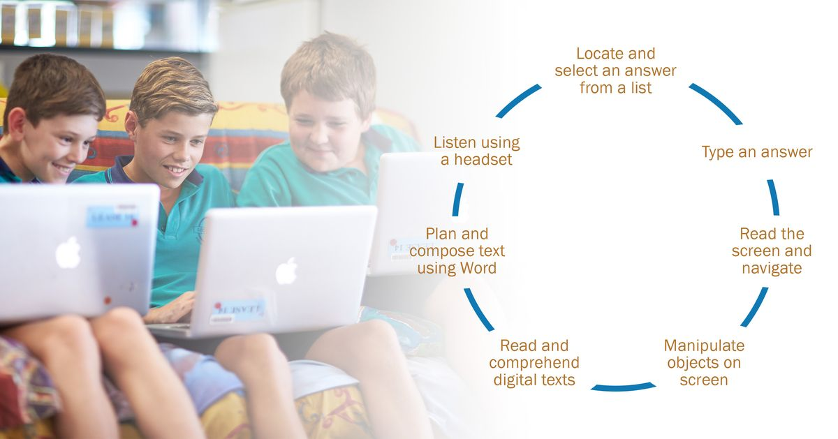
Do your students have the following skills?
Notes:
Key skills that students and teachers need to be successful at NAPLAN online
By integrating ICT into daily teaching and learning teachers and students become more comfortable with the skills. The goal is for the technology to become a transparent tool to help students show what they know.
The following slides support the 3 Phase Approach for schools to embed NAPLAN Online skills and the use of technology in everyday learning.

Slide 13

How can I best prepare my child to complete NAPLAN Online?
Ensuring students are familiar with using devices, typing on them and navigating through programs is a part of students everyday learning and a requirement of the NSW Curriculum.
You can help your child become familiar with NAPLAN Online by accessing the public demonstration site on the NAP website. The demonstration site includes useful resources for schools to help students become familiar with the online test experience.
http://nap.edu.au/online-assessment/public-demonstration-site

Slide 14
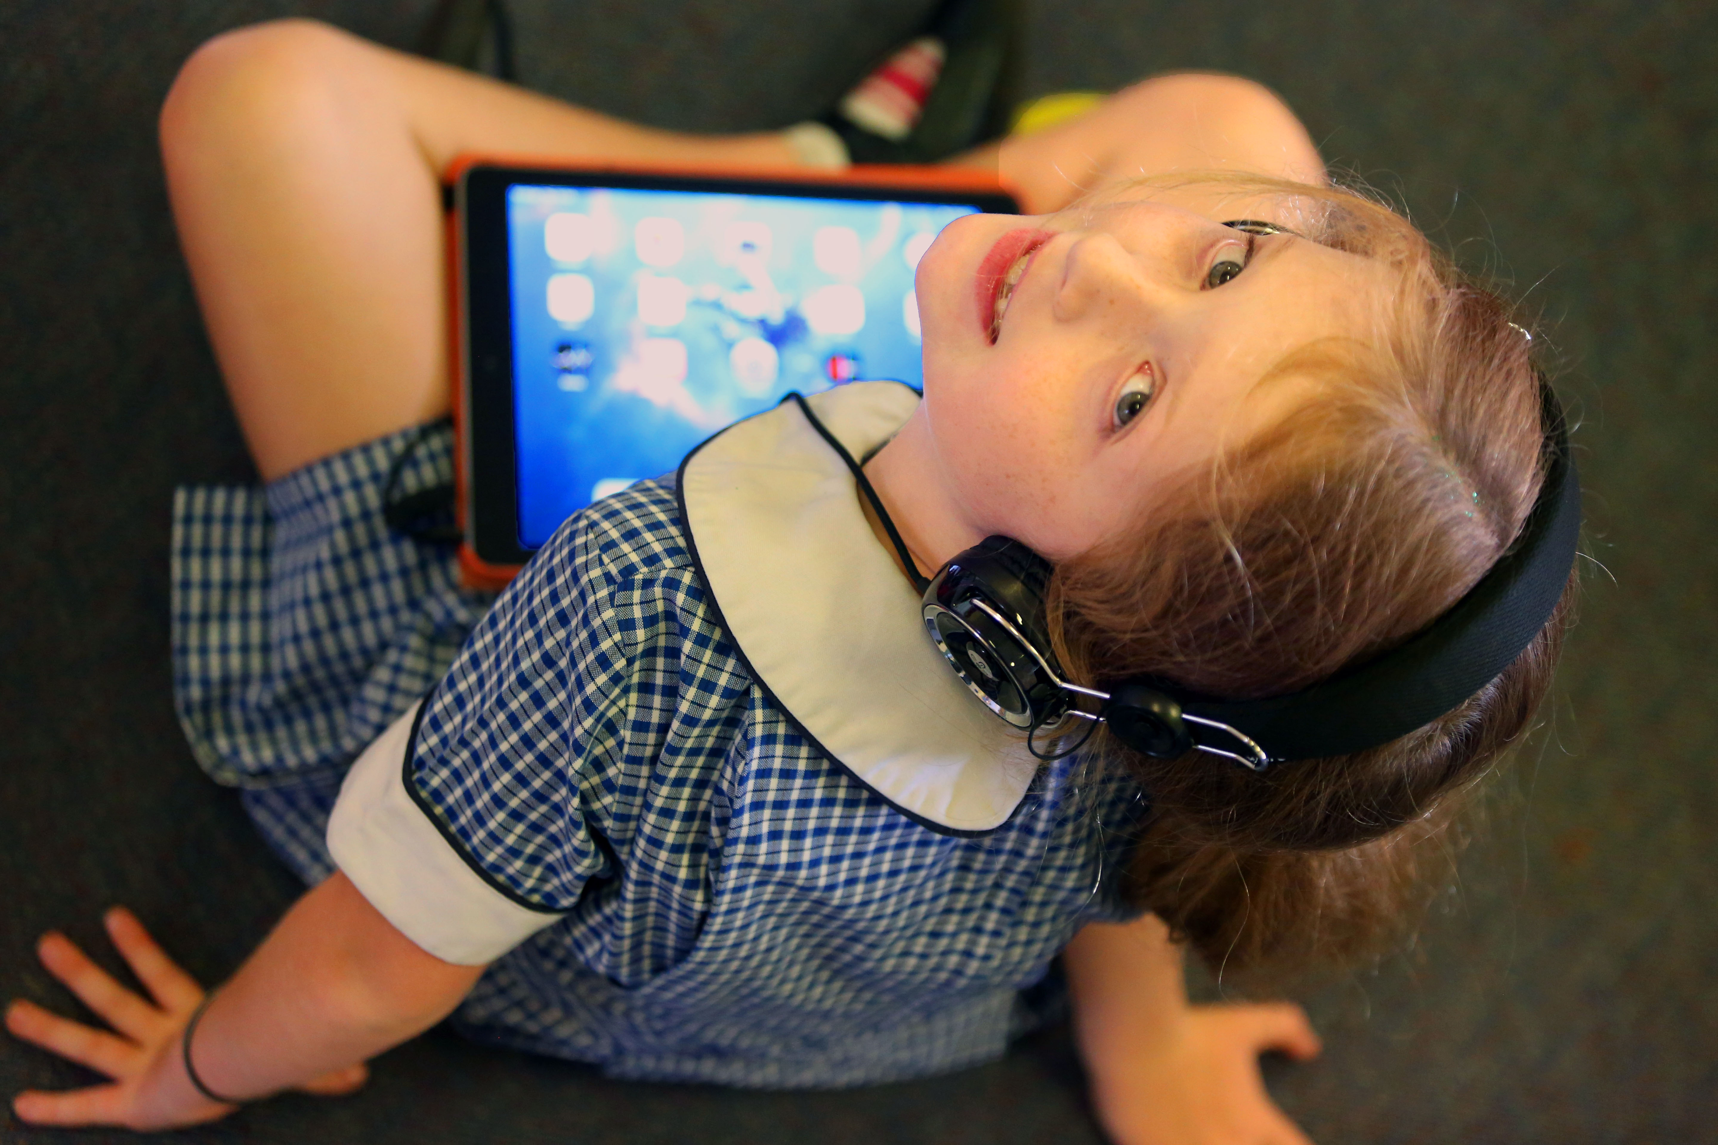

Public Demonstration website
Public demonstration site mini-tests
Tests that provide an example of what type of questions student will encounter.
Interaction tests
Provides general instructions for students in how to interact with different item types.
Accessible interaction tests
Accessible interaction test provides schools with examples of adjustments that are made by applying different adjustments. (audio and visual)
Notes:
Obviously key to preparing your students is to engage as much as possible with online assessments, such as the public demonstration website. The ICT skills guide also allows students to practice those specific skills they will require such as:
Drag and drop
Scrolling
Moving between screens, etc.
Typing programs:
Results from ACARA on the comparison between traditional testing and online testing showed that the students wrote the same amount – if not more than they did with pen and paper. The recommendation is that students need more experience with creating, composing and editing on devices than gaining typing speed. It is their familiarity and comfort with the device that increases their result not typing speed. This can be achieved by integrating ICT into daily classroom practise eg: journal writing, brain storming, classroom blogs, book and movie creation and many more.
ICT lab/ teacher:
Students will have a much more authentic experience if technology is integrated into daily activity, than as a stand alone event once per week. Some school have invested in a Technologies teacher to provide advanced skills for students but still have devices in class with the expectation that classroom teachers will integrate technology into core curriculum area’s such as maths, English, hass and science and incorporate ICT general capabilities.
Putting technology into each classroom and providing PL on effective use of technology, increases students success.
PISA report:
Computer-based tests were used, with assessments lasting a total of two hours for each student.
Are there computers in the classroom? Does it matter? Students, Computers and Learning: Making the Connection examines how students’ access to and use of information and communication technology (ICT) devices has evolved in recent years, and explores how education systems and schools are integrating ICT into students’ learning experiences. Based on results from PISA 2012, the report discusses differences in access to and use of ICT – what are collectively known as the “digital divide” – that are related to students’ socio-economic status, gender, geographic location, and the school a child attends. The report highlights the importance of bolstering students’ ability to navigate through digital texts. It also examines the relationship among computer access in schools, computer use in classrooms, and performance in the PISA assessment. As the report makes clear, all students first need to be equipped with basic literacy and numeracy skills so that they can participate fully in the hyper-connected, digitised societies of the 21st century.
The results showed no appreciable improvements in student achievement in reading, maths or science in countries which had invested heavily into ICT for education. It also indicates that to build deep understanding and conceptual learning and higher order thinking requires intensive teacher – student interactions. Another main point is that we have not become good enough at the kind of pedagogies that make the most of technology, adding that 20th century practices will just dilute the effectiveness of teaching with technology. If students use smart phones to copy and paste prefabricated answers to questions, it is unlikely to help them become smarter. If we want students to be smarter than a smart phone we need to think harder about the pedagogies we use to teach them.
Technology can amplify great teaching but great technology cannot replace poor teaching.

Slide 15

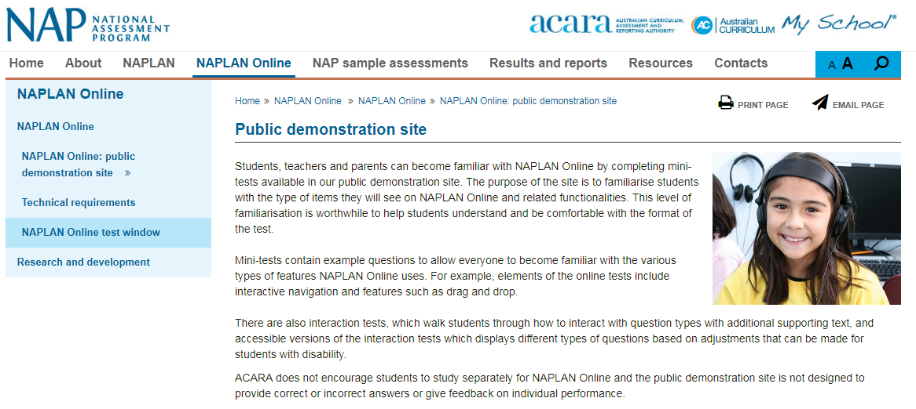
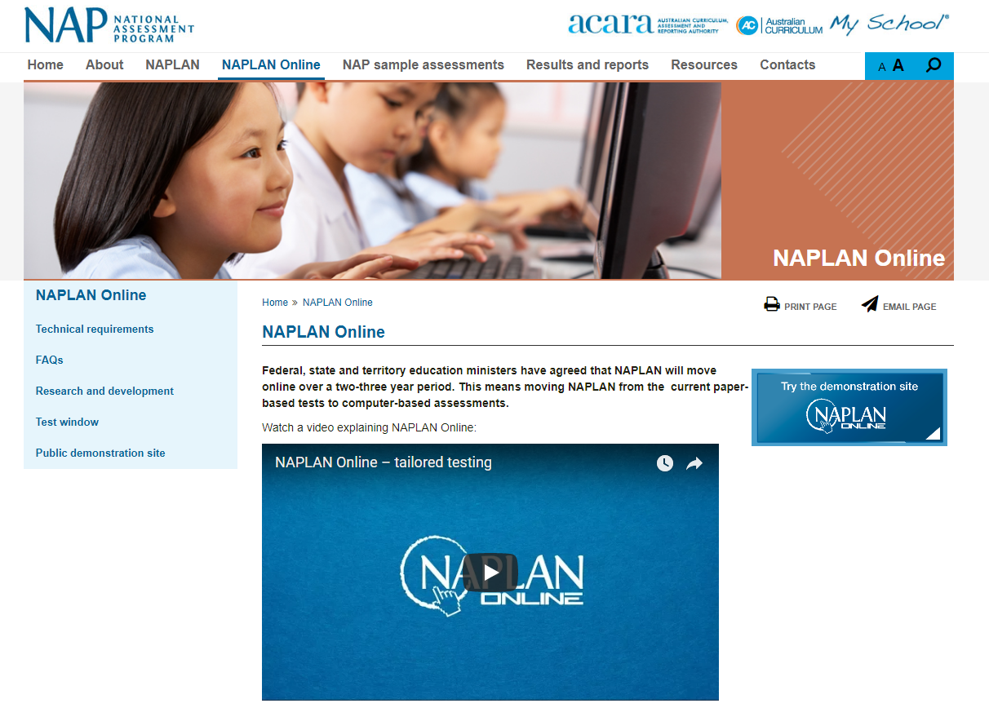
Public Demonstration Site
www.nap.edu.au
Notes:
It our responsibility as a school to take students through the Public Demonstration Site to familiarise them with the style of test that will be presented to them.
When students take a demonstration test, they will see a range of different question types. Some of these include: multiple choice/s, checkbox, text entry, drop down list, drawing lines and drag and drop. Students may need familiarisation with some of these question types.
Note, that this is also a website that parents can access to see what their children will experience in the online test.
There are several ways to access this site:
NAP website – as on the screen. Select NAPLAN Online > Try the demonstration site
NAP Locked down browser – on student devices: select Student demonstration tests

Slide 16
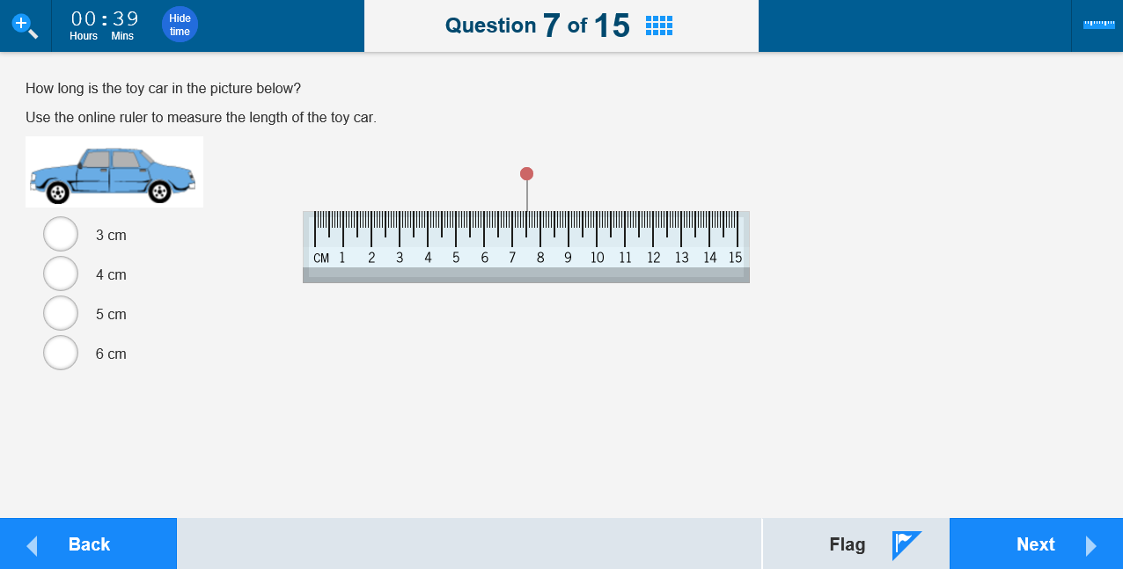
Public demonstration site
Notes:
[Boxes in red are animated to appear upon clicks]
In addition to the familiarisation of the different question types, students should be shown the different features on the page they are viewing. For example:
Top left corner – magnifier tool and timer. The magnifier tool allows students to enlarge the screen they are using. Note that this may require scrolling to view the whole question. The timer counts down the test time remaining for the student. Students can select the Hide time button to hide the timer if they prefer. The timer flashes to alert students when there is 5 minutes left on the test.
Top centre – indicates a student’s current test question and the number of items.
Also, top centre – the grid icon opens a progress summary screen.
Top right – tool symbol which is available for some items only. This item is a numeracy question that requires a ruler. When selected, it appears in the middle of the screen. The calculator may also been seen in Year 7 & 9 numeracy tests.
Bottom left - Back button. To move back to previous questions if needed. In the opposite bottom right corner is the Next button to progress through the questions.
Bottom right - Beside the Next button is the Flag button, which allows students to flag a question they might want to go back to later.

Slide 17
Student success
“The key factor influencing students’ interaction with online items and tests is their
familiarity with the device that they are using to complete the tests.”
Laurie Laughlin Davis, Ph.D. Device Effects in Online Assessment: A Literature
Review for ACARA, September 2015.
Laurie Laughlin Davis, Ph.D., Irene Janiszewska, Robert Schwartz, Ph.D., Laura Holland NAPLAN Device Effects Study. Pearson, Melbourne, March 2016

Slide 18

FAQS
ACARA`s NAPLAN Online website has an in-depth ‘Frequently Asked Questions’ section that is helpful to families. This can be access through the link:
http://nap.edu.au/online-assessment/FAQs
You can also visit the 'Resources' section of the NAP website for access to NAPLAN Online resources.
http://nap.edu.au/resources-new

Slide 19
Further resources
Factsheets and FAQs
Moving NAPLAN online ACARA research and findings
Small scale tests
NAPLAN Online technical requirements
Tailored testing fact sheet ( 288 kb)
NAPLAN Writing test FAQ ( 1.6 mb)
FAQ Comparability of paper and online NAPLAN tests ( 431 kb)
Infographics
NAPLAN Online - A better assessment for all ( 1.7 mb)
NAPLAN Online test window ( 796 kb)
NAPLAN Online and protecting privacy infographic ( 1.4 mb)

